Slide 1
Who will subscribe
to a term deposit?
Project 2 · Machine Learning: From Data to Predictions
Predicting the outcome of a bank’s phone calls before they’re made
Tamim Wahage
Notes:
Time: 0:20 (total 0:20). Hi, I’m Tamim. My project is about a bank that sells term deposits by phone, and whether we can predict who says yes before we call them.

Slide 2
The problem
A Portuguese bank calls clients to sell them a term deposit. Most calls end with a no.
What I predict: will this client subscribe? (before the call)
For whom: the marketing team planning the call list
What they do with it: call the likely clients first, skip the ones who’ll almost surely say no
Notes:
Time: 0:40 (total 1:00). The bank runs phone campaigns. Every call costs an agent’s time, and most clients say no. So the idea is: before we call someone, predict if they’ll subscribe. The marketing team can then sort the call list and skip the hopeless ones.

Slide 3
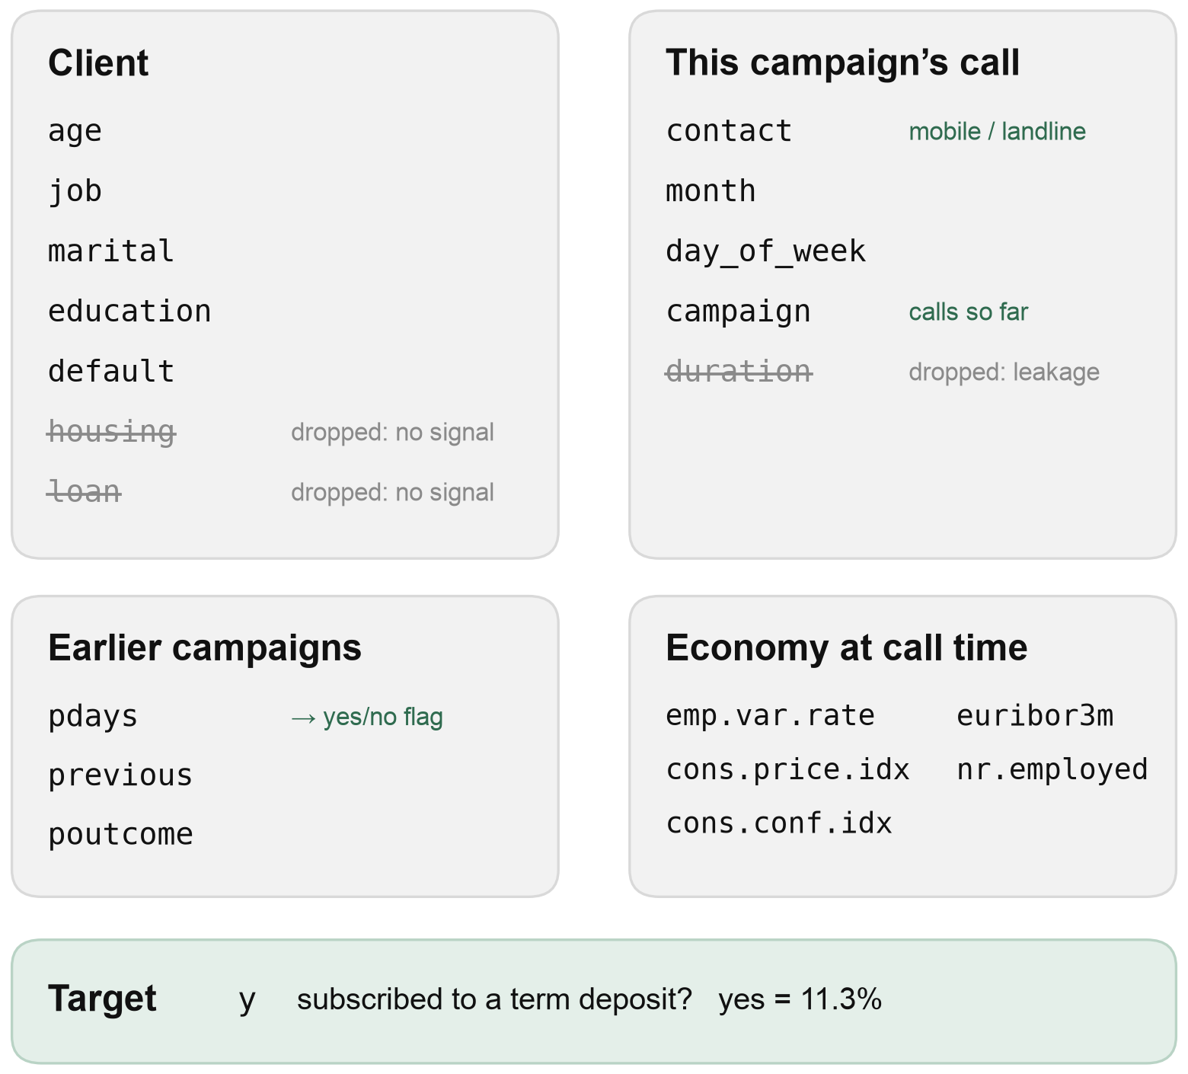
The data
41,188 phone contacts, May 2008 – Nov 2010. One row = one call to one client: client info, earlier contacts, the economy at that time.
The traps I found
duration (call length) is only known after the call → dropped (leakage)
missing values hide as “unknown” and pdays = 999 → kept as a category / replaced by a flag
12 exact duplicates → dropped
the file is sorted by date and the economy columns act like a hidden date
Source: Moro, Rita & Cortez (2014), Bank Marketing, UCI Machine Learning Repository, doi.org/10.24432/C5K306. Licence: CC BY 4.0.
Notes:
Time: 0:40 (total 1:40). The data is the UCI Bank Marketing dataset, 41k calls over two and a half years. A few traps: the call duration predicts the answer almost perfectly, but you only know it after the call, so it had to go. Missing values are hidden as “unknown” and 999. And the rows are sorted by date, which becomes important later.

Slide 4
The metric and the baseline
Only 11.3% say yes. Saying “no” to everyone is 88.7% accurate and finds nobody.
Baseline: call everyone
A missed yes (lost sale) is worse than a wasted call.
0.203
So: F1, which is only high if the model finds the yes clients and is right when it calls.
F1 to beat (finds every subscriber, but 89% of the calls are wasted)
Notes:
Time: 0:45 (total 2:25). Only about one in nine clients says yes. That makes accuracy useless: a model that always says no is 89% accurate and never finds a customer. A missed yes is a lost sale, so I use F1, which balances finding the subscribers and not wasting calls. The baseline is what the bank basically does now: call everyone. That gives an F1 of 0.203, and that’s the number every model has to beat.

Slide 5
What I tried
4 model families × 6 ways to handle the 11% yes (none, class weights, random oversampling, SMOTE, random undersampling, cluster centroids), same 5 folds, each at its best threshold. Best of each:
Model | Imbalance handling | F1 (mean ± spread) | Recall
Gradient boosting | class weights | 0.499 ± 0.014 | 57%
Logistic regression | random oversampling | 0.485 ± 0.012 | 57%
Random forest | random undersampling | 0.466 ± 0.014 | 50%
Decision tree | SMOTE | 0.338 ± 0.014 | 37%
Baseline: call everyone |  | 0.203 | 100%
The model family matters, the imbalance method hardly does: once the threshold is moved, every method except cluster centroids lands within the fold spread. Tuning didn’t beat the default settings.
Notes:
Time: 0:50 (total 3:10). I compared four model families, and each one with six ways to handle the imbalance: nothing, class weights, copying yes clients, SMOTE, throwing away no clients, and cluster centroids. All on the same folds, each at its best threshold. Everything beats the baseline. Gradient boosting with class weights is best, logistic regression second; the gap is small, but gradient boosting wins on every single fold. The imbalance method hardly matters, only cluster centroids clearly hurts. I also tuned the two best ones, but the defaults were already as good, so I kept them.

Slide 6
Imbalance and the threshold
Gradient boosting, cross-validated F1 for each way to handle the 11% yes:
Method | at threshold 0.5 | at its best threshold
No handling | 0.365 | 0.497
Class weights | 0.475 | 0.499
Random oversampling | 0.469 | 0.497
SMOTE | 0.426 | 0.494
Random undersampling | 0.440 | 0.490
Cluster centroids | 0.203 | 0.209
Don’t leave the threshold at 0.5. F1 is best at 0.65. A missed yes costs more than a wasted call, so I went one step lower to 0.60: it finds more subscribers, and F1 stays just as good.
Notes:
Time: 0:35 (total 3:45). With only 11% yes, the model has to be pushed to say yes more often. Here are all six methods for gradient boosting. At the default threshold the difference is big, but once you move the threshold they all end up at the same F1, except cluster centroids, which throws away too much data. So the threshold is what matters. I chose 0.60: F1 is almost at its best there, and since a missed customer is worse than a wasted call, I take the lower threshold that finds a few more of them.

Slide 7
The final model on the test set
Test set (used once)
Cross-validation
Baseline (call everyone)
0.519
0.496
0.203
F1
± 0.012 across folds
F1
With 15% of the calls the model reaches 61% of the subscribers. Calling everyone: 100% of the calls, and 89% of them are wasted.
How: the test set has 8,236 clients, 928 of them subscribers. The model calls 1,248 of them (15%), and 565 of those subscribe: 565 / 928 = 61%. Calling everyone, only 11.3% say yes, so 89% of the calls are wasted.
Notes:
Time: 0:40 (total 4:25). On the test set, used only once at the very end, the model gets 0.519. That’s close to the cross-validation estimate, so no sign of overfitting, and about 2.5 times the baseline. In business terms: the bank would make only 15% of the calls and still reach 61% of the people who would subscribe.

Slide 8
Where it goes wrong
The model mostly recognises the time period, not the client. Test set, grouped by the economy at the time of the call:
Period (nr.employed) | Clients | Said yes | Called | Found
Worse economy (≤ 5076) | 975 | 46% | 96% | 98%
Middle (5099) | 1,695 | 14% | 17% | 50%
Better economy (5191–5228) | 5,564 | 4.5% | 0.4% | 4%
Also weak: landline clients (finds 33%) and clients never contacted before (finds 48%).
Notes:
Time: 0:50 (total 5:15). This is the most important slide. When I split the test errors by period, the model basically does two things: in the bad economic periods, where almost half the people said yes, it calls nearly everyone. In the good periods it calls almost nobody and misses nearly all subscribers there. Only in one period does it really pick client by client. So a big part of the score comes from knowing when the call happened. It’s also weak for landline clients and for clients who were never contacted before.

Slide 9
What drives it
Permutation importance (drop in test F1)
For the bank
Column | Drop
nr.employed (economy) | 0.23
cons.conf.idx (economy) | 0.05
poutcome (last campaign) | 0.02
euribor3m (economy) | 0.02
month | 0.02
When a client is called matters more than who they are: in bad economic times many more people took a deposit.
Within a period: past success, a mobile number, being young or retired.
Notes:
Time: 0:40 (total 5:55). Permutation importance says the same thing: shuffle nr.employed and F1 drops by 0.23, way more than anything else. The economy columns share their importance because they move together. For the bank this means: timing matters more than the client. Within a period, the good signs are a success in the last campaign, a mobile number, and young or retired clients.

Slide 10
Conclusions and limitations
Future check: trained on older calls, tested on newer ones → F1 0.398, worse than calling everyone in that period (0.468).
Would I use it?
With another week
Not as it is for a new campaign
Use the patterns now: always call past successes, mobile numbers, students and retired
Don’t call the same client again and again
Test on later campaigns instead of a random split
Keep the economy, but in a form that carries over to new periods (e.g. trends instead of exact values)
Real call costs and deposit value from the bank
Retrain on recent campaigns
Notes:
Time: 0:55 (total 6:50). The honest conclusion: the random test split flatters the model, because train and test come from the same periods. When I trained on the older calls and tested on the newer ones, it did worse than calling everyone in that period. So I wouldn’t use it as it is for a new campaign. But the patterns are useful right away. With another week I’d test on later campaigns instead of a random split, keep the economy information but in a form that still works in a new period, and get real costs from the bank to set the threshold with money.

Slide 11
Live demo
The saved model (pipeline + threshold 0.60) is loaded and asked about one client, a 67-year-old retired person with a mobile number:
Same client, called… | P(yes) | Decision
in a bad economic period (Oct, low rates) | 0.81 | call
in a good economic period (Jul, high rates) | 0.37 | skip
good period, but last campaign was a success | 0.69 | call
notebooks/03_evaluation_and_interpretation.ipynb · section 5
Notes:
Time: 3:00 (total 9:50). Switch to notebook 03, section 5. 1) Run the cell that loads models/bank_marketing_model.joblib. 2) Run the five test clients: one gets a call, four are skipped, which fits the 15% call rate. 3) Run the made-up client: retired, 67, mobile, called in a bad economic period: 0.81, call. 4) Run the same client in a good period: 0.37, skip. That’s the period effect from the errors slide. 5) Give the same client a past success: 0.69, call again. Close with: the model works, but it mostly knows when to call, not who.

Slide 12
Thank you
Who will subscribe to a term deposit?
Tamim Wahage · Questions welcome
Notes:
Time: 0:10 (total 10:00). Thank you, happy to take questions.

